Slide 1
Lecture 17:
Green and Saffron Politics in India
Course: Environment and Politics in India

Slide 2
Environmentalism and Right-wing mobilization
Difference between religion-ecology relationship and POLITICAL mobilization of religion based on the environment.
TWO elements:
Greening of Saffron: Ganga protection, opposition to Tehri dam.
LIMITS? Tehri versus SSP, Enron power project.
Saffronizing of Green: Providing a Hindu-cultural hue to environmental mobilization.
Notions of purity/pollution, sacred/non-sacred, holy/unholy, indigenous/foreign, local/migrant…
Redefinition of POLLUTION:
Environmental consciousness = Notion of ‘pure’, unadulterated, indigenous CULTURE. Anything else is environmental POLLUTION.

Slide 3
Environmentalism and Right-wing mobilization
Dear Ganga, the current of the Saryu river has risen.
You too must arise!
Draw within your folds the vast pollution that has collected!!
Come mother, come!!
The grave of communism has been dug.
Blood is filled with the exploitation of wealth.
The earth is burning with Saddams.
Come mother, come!!
- O Holy Mother Ganga!, Mathan
THEMES? Past glory in the Vedic Age, Valorization of the Village society/Economy, ‘Indian’ culture.
ECO-ENEMIES? Immigrants, Migrants, Minorities. Pollution of the Hindu ‘national’ identity

Slide 4
Case Study – I
Ralegan Siddhi
BACKGROUND factors
History of Nativism and Regionalism in Maharashtra. Marathas versus Mughals (Hindu Pad Padshahi), Gokhale, Shiv Sena, MNS
Structure and Nature of Caste and Class in Maharashtra. Maratha-Brahmin hegemony, OBC/Dalit Assertion.
Agrarian situation (status of land reforms/tenancy, regional development), Rural Elites (controlling cooperatives, local governments/educational institutions)
Local environmentalism. Sacred groves, Baba Amte, Bali Raja dam.

Slide 5
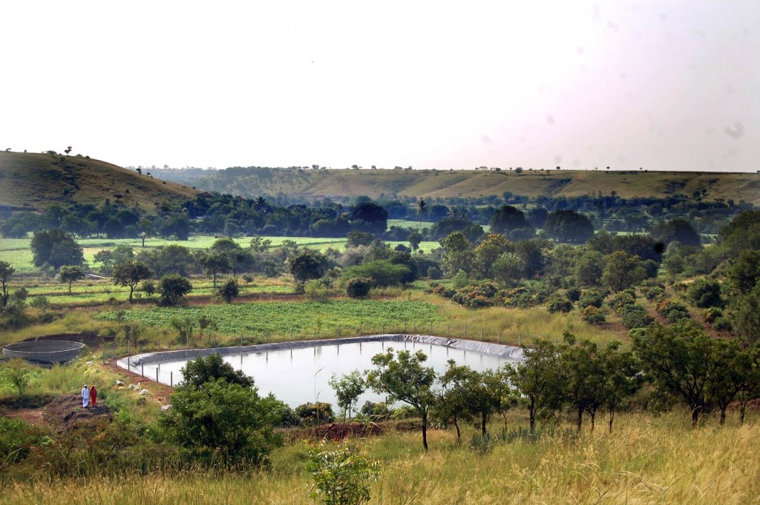
Case Study – I

Slide 6
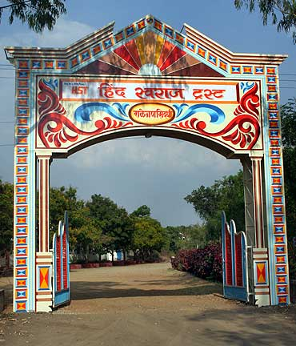
Case Study – I

Slide 7
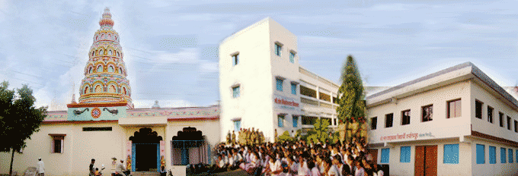
Case Study – I

Slide 8
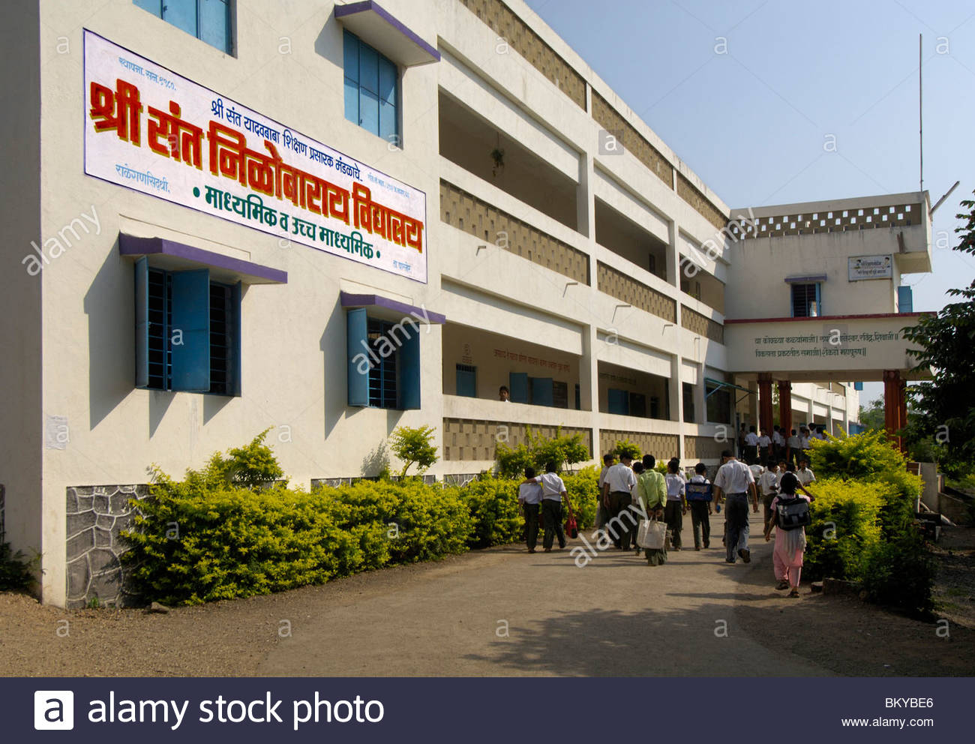
Case Study – I

Slide 9
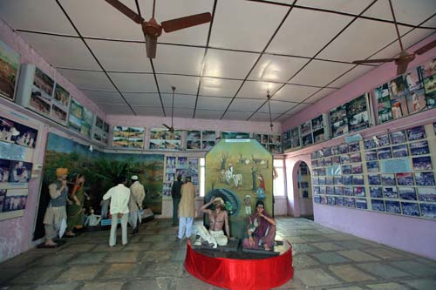
Case Study – I

Slide 10
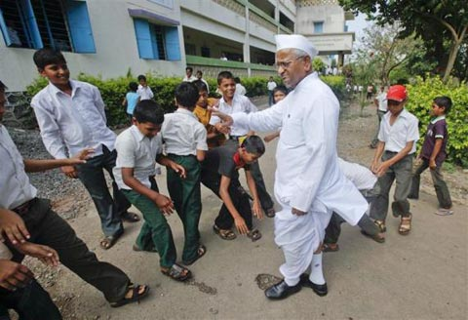
Case Study – I

Slide 11
Case Study – I
CATCH WORDS/THEMES:
Shram Shakti
Daan
Gramin Vikas
ANNA HAZARE in Ralegan Siddhi:
Bachelor, clad in Khadi.
Lives in the local temple (which he renovated out of his savings).
Holds absolute power. HOW? Combination of persuasion, coercion and suppression?
Charismatic authority: Exceptional powers, personal qualities.

Slide 12
Case Study – I
BELIEF SYSTEM
People’s NATURAL duty to obey figure of authority.
Figure of authority has a NATURAL duty to rule.
  “Whatever Anna says, we do…we all obey his orders…Annaji is like God. Whatever work he will assign, I will fulfill and never say no…Annaji has become my nature, my habit. He is my heart”.
EXAMPLE: Dindi yatra, Hazare’s birthday celebrations…
How was village integration/Village=family logic enforced? NOT ‘logic’, but construction of a mythical, GOLDEN, past.
“In olden days, our country had a lot of wealth. We had a great civilization. Our people were strong. Our villages were places of mutual love, affinity, and closeness. There was a lot of community work, as people used to build the temple, the school, and the tank together…Our mythology refers to 33 crore gods. They are actually 33 crore people, with godly thinking and behavior. Cow’s milk was the main ingredient for growth at that time and this is why the cow was called the mother of 33 crore gods. Now we have lost our national culture, pride, and spirit” – Anna Hazare

Slide 13
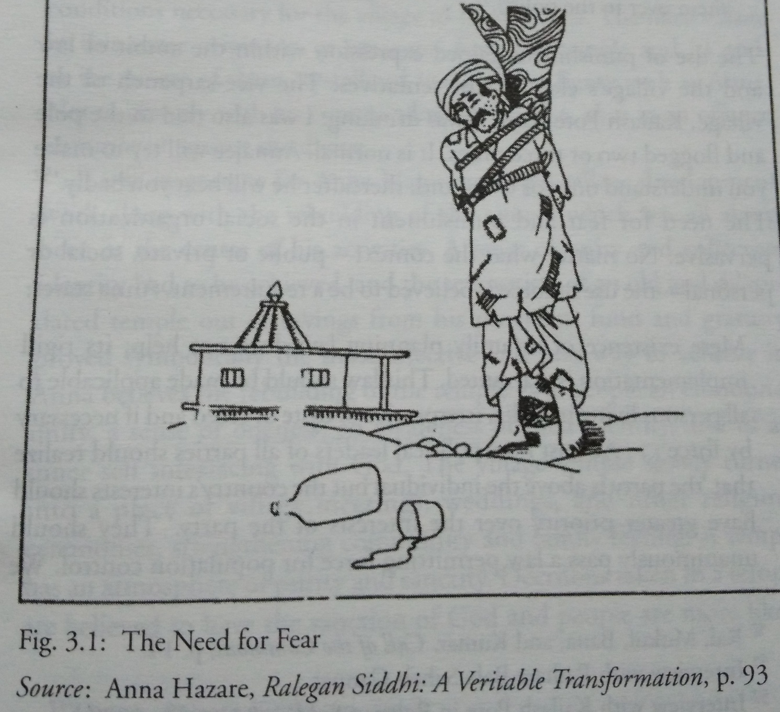
Case Study – I
FORCE and PUNISHMENT
Fear, physical AND social/’moral’ force. Social ostracism/public punishment.
EXAMPLE: Alcoholism, family planning.

Slide 14
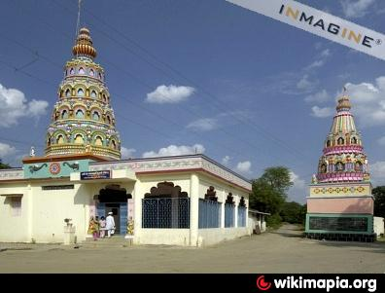
Case Study – I
RELIGION and RELIGIOUS symbols
Role of the temple: Symbolism, identity, subservience to the ‘DIVINE’, facilitating command-obedience relationship.
Multiple, accessible, Gods. Invocation of Ram/Krishna.

Slide 15
Case Study – I
RULES and CODES
Strict adherence required for social/political/environmental life. Army-like discipline
5 MAIN RULES:
Nasbandi
Nashabandi
Charaibandi
Kurhabandi
Shramdan
No TV. Only religious films allowed.
Assent COMPULSORY
Enforced Vegetarianism
NO sugarcane farming (to conserve water)
NO elections to gram panchayat/cooperative societies allowed. Only nominations. Discourse against party politics.

Slide 16
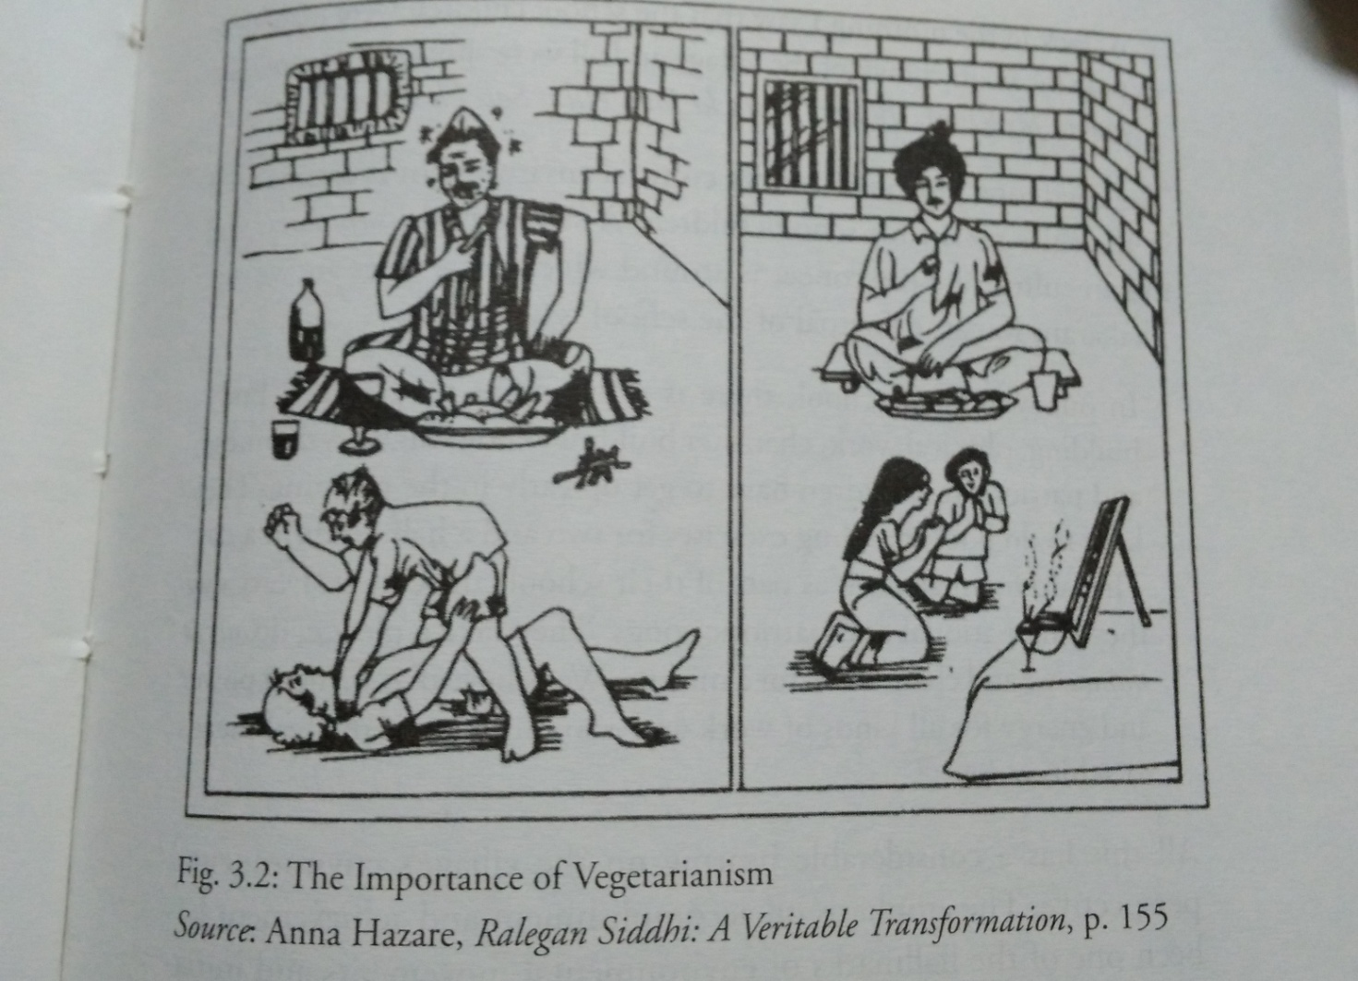
Case Study – I
Hum sab ek hain…BUT what is the EK?
Questions of MEANS, PROCESSES, FREEDOM, DEMOCRACY? How to deal with CONFLICT and CONTRADICTION?

